Slide 1


Data Analytics on Salary Trends
Sujala Potula

Slide 2

Analysis of salary trends based on
Age
Gender
Education
Industry
Industry experience

Slide 3




Questions
1. How does education level impact salary across different industries and genders?
2. Are there any gender –based disparities in different industries and education levels?
3. How does industry experience impact salary across different genders and education levels?

Slide 4

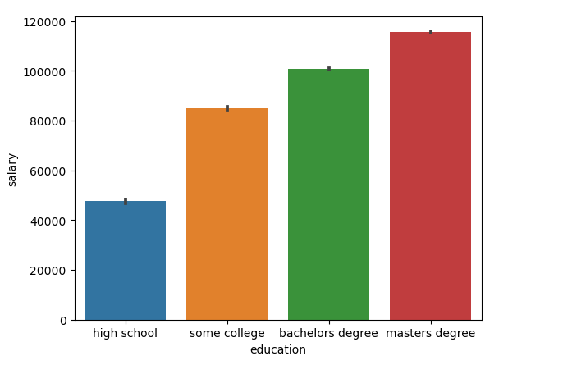
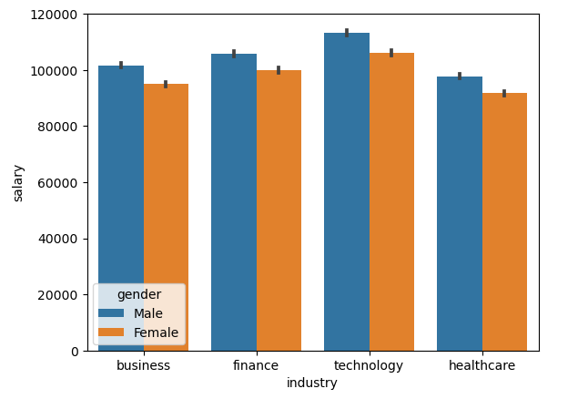
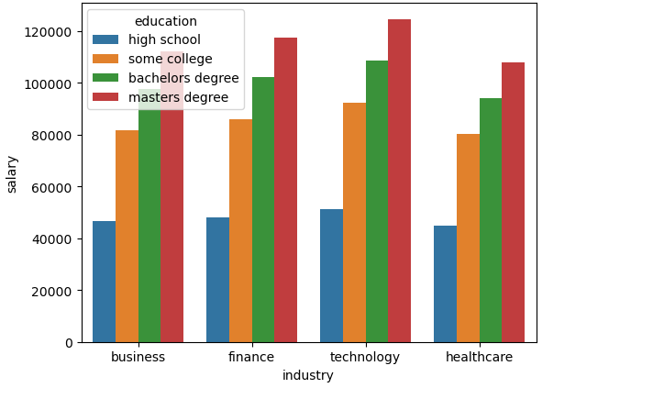
Impact of Education on Salary Across Industries and Gender
Analysis :
People with higher education degree will tend to have more salary.
In any kind of industry men tend to have slightly more salaries than women.
People in technology with higher education can tend to have more salaries than any other industry.

Slide 5
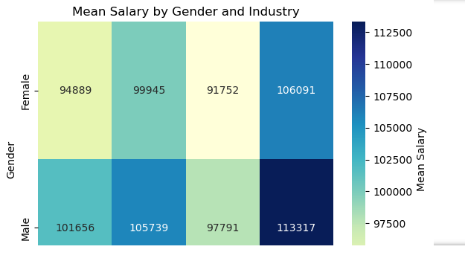
Question2: Are there any gender-based salary disparities in different industries and education levels?
Analysis:
From the plot, we can observe that there are certain industries where there is a significant gender-based salary disparity, such as the finance and insurance industry, where males tend to earn a higher salary than females.
On the other hand, in some industries, such as the information industry, there is no significant difference in salaries between genders. Additionally, we can see that generally, individuals with higher education levels tend to earn a higher salary in all industries and for both genders.

Slide 6
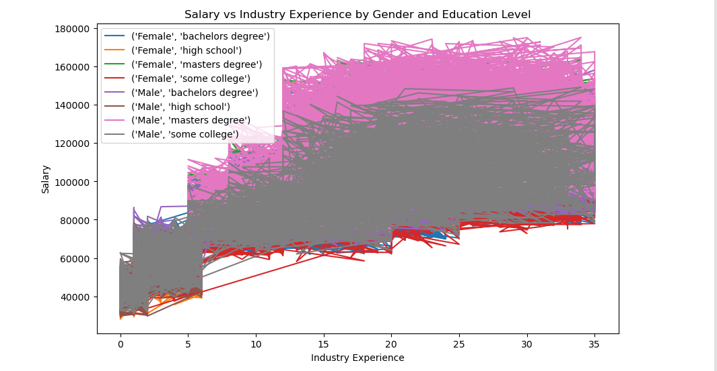
Question 3: How does industry experience impact salary across different genders and education levels?
Analysis:
From the plot, we can observe that the salary increases as industry experience increases for all three levels of education. We can also notice that the slope of the line for masters degree is steeper than high school and some degree ," indicating that having a higher degree leads to a higher salary for the same amount of industry experience. Additionally, we can see that the salary for females is consistently lower than males for each level of education and industry experience.

Slide 7

Summary:
The analysis shows that individuals with higher industry experience tend to have higher salaries and as individual age,their salaries tend to increase as well.

